Slide 1

Math Lesson 93

Slide 2
Lesson 93: Creating Problems (with reasonable answers) Involving Volume of a Cube and Rectangular Prism in Real-Life Situations

Slide 3
Drill
Have a drill on the finding the volume of cubes and rectangular prism.
Example:
15 cm
15 cm.
5 cm
15 cm.
15 cm.
10 cm.

Slide 4
Review
Have a review on solving problems on volume.
What are the steps in solving word problems?
Let the pupils solve this problem.
Leo has a box measuring 15 cm long, 20 cm wide and 10 cm high. Find its volume?

Slide 5
Group the pupils into four and let them read the problem and ask them to draw the solid figure described in the problem.
A rectangular garden is 25 cm long, 15 cm wide and 10 cm thick. What its volume?
Ask: Can you create a problem on volume similar to the one given?
Say: This time you will create problems involving the volume of a cube and a rectangular prism.

Slide 6
Presentation
Each group will present the solid figure formed.
What is asked in the problem?
What are the given data?
What process is needed to solve the problem?
What is the number sentence?
What is the correct answer?

Slide 7
Group Work Activity
Divide the class into four groups. Let each group discuss how they will make a problem based on the given situations. The first two groups will discuss situation 1 and the remaining two groups will focus on situation 2.

Slide 8

Situation 1:
Ana has a front yard measuring 15 m long and 8 m wide.
She wants to elevate it by $\frac{1}{2} meter.$

Slide 9
Situation 2:
Lito’s business is to deliver water to schools.
Her water tank measures 4 meters long, 2 meters wide, and 2 meters high.
Every morning, he delivers a tank full of water to each of the schools

Slide 10
After the activities are done, let the groups post their created problems from the given situations and let them follow the task below.
Read the problem and ask the class to solve the problem.
Illustrate and solve the problem with its solution.

Slide 11
How did you create problems?
Expected answer:
We familiarized ourselves with the mathematical concepts and their application to real-life situations.
We thought of the type of problems we want to create.
We read and studied some problems that we have solved and their solutions.

Slide 12
Study the problem.
Karen has a rectangular prism with the dimensions shown in the diagram below.
8 cm.
3 cm.
5 cm.

Slide 13
Can you create a problem about Karen’s rectangular prism?
You can create a problem by using the steps below:
Familiarize yourself with the concept. Think of an application to everyday life situations.
Think of the type of problem you want to create and the formula to be used. Relate the problem to a real-life situation.
Read some problems and study their situations.
Make your own styles/strategies to justify your solutions.

Slide 14
Below are the examples of problem that you can create:
What is the volume in cubic cm of Karen’s rectangular prism?
Karen’s rectangular prism measure 3 cm long, 5 cm wide, and 8 cm high. What is its volume?

Slide 15
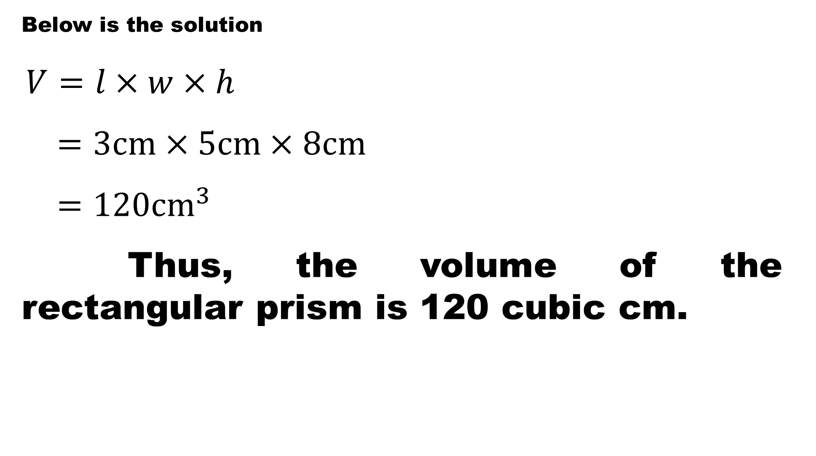
Below is the solution
$V=l×w×h$
$=3cm×5cm×8cm$
$=120{cm}^{3}$
Thus, the volume of the rectangular prism is 120 cubic cm.

Slide 16
Make a problem involving the volume of a rectangular prism with the corresponding answer based on the given situation.
An antique wooden chest is in the form of a cube. Its edge measures 5 cm.
Problem:
Answer:

Slide 17
2. A closet measures 4 m long, 5 m wide, and 3 m high.
Problem:
Answer:
3. A flower box is 7 m long, 3 m wide, and 20 cm high.
Problem:
Answer:

Slide 18
4. Robles family made a fish pond in their backyard measuring 5 meters long, 4 meters wide, and 5 meters deep. They sold the soil for Php50 per cubic meter.
Problem:
Answer:

Slide 19
What did you do to be able to create problems involving the volume of cube and a rectangular prism?
What are the steps in creating problems?

Slide 20
Steps in creating problems.
Familiarize yourself in the concepts. Think of an explanation to everyday life real situations.
Think of the type of problem you want to create and the formula to be used. Relate the problem to real life situations.
Study the solution in solving the problems.
Make your own styles/strategies to justify the solutions.

Slide 21

Make a problem involving the volume of a rectangular prism.
A rectangular seed box which measures 30 dm long, 15 dm wide, and $\frac{1}{2} dm$ high is to be filled with soil.
The Reyes family dug a compost pit which measures 5 m long, 2 m wide, and 3 m deep.
An aquarium which is to be filled with water, measures 55 cm long, 40 cm wide, and 25 cm high.

Slide 22
Let the pupils make problems involving the volume of a rectangular prism with corresponding answers based on the given situations.
In constructing a new building, a hole 4 m deep, 10 m wide, and 115 m long was dug in the ground.
A room is 15 m high, 4 m wide and 10 m long.
A bar of gold is 25 dm long, 3 dm wide, and 2 dm high.

Slide 23
Let the pupils create problems involving volume, then provide solutions.
Ana’s sewing box is 7 dm long, 4 dm wide and 3 dm high.
An antique wooden chest is in the form of a cube. Its edge is 20 cm.

Slide 24

Enrichment
Let the pupils create problems for the following situations:
A small gift box measures 8 cm long, 7 cm wide and 2 cm high.
A rectangular water tank is 5 meter high, 2 m wide and 3 m long. It contains water 2 meter high.
The volume of a rectangular prism is $75 {cm}^{3}$, its height is 6 cm, and its length is 4 cm.

